Slide 1


NutriChef – ML and CNN based nutrient analysis and culinary exploration
(Paper ID - 13)
Jeet Agrawal
Department of Information Technology, Tulsiramji Gaikwad Patil College of Engineering and Technology, Mohgaon, Nagpur
Organized by Tulsiramji Gaikwad-Patil College of Engg. & Technology, Nagpur

Slide 2
INTRODUCTION
NutriChef is designed to revolutionize how we approach nutrition and healthy eating. Our primary focus is on providing comprehensive nutritional analysis for a wide range of foods, empowering users to make informed decisions about their diet. Alongside this essential feature, NutriChef also offers a vast collection of delicious recipes and other food related insights tailored to individual preferences and dietary needs. By combining scientific expertise with culinary innovation, we aim to inspire and guide users towards making healthier choices in their everyday lives.
1

Slide 3
NEED OF PROJECT
Wikipedia
Nestle
Indian Times
60% of food & beverage products available in Indian markets are unhealthy.
42% of the world's population cannot afford a healthy diet, figure is a huge 71% for India.
India has 31 cuisines and at least 50,000 regional dishes.
Times of India
Lancet Journal
LiveMint
92% of people choose unhealthy food options unknowingly in India.
Indian fast food industry is grew by 40% every year and it’s worth is US $27.5 billion in 2020.
More than 1.5 million people in India die due to unhealthy diets.
1

Slide 4
LITERATURE SURVEY
Title : Inverse Cooking : Recipe Generation from Food Images (2018)
Author : Salvador A, Michal Drozdal, Xavier Gier-i-Nieto, Adriana Romero.
Journal : ArXiv Preprint ArXiv:1804.01378, Volume 1.
Technique : Convolutional Neural Networks (CNNs) and Recurrent Neural Networks (RNNs). Contribution : The paper proposes a novel approach to recipe generation from food images, which is an important problem in computer vision and natural language processing. The model uses a modified version of the encoder-decoder framework.
Drawbacks : The model generates ambiguous or incorrect instructions, which could lead to poor results or even unsafe cooking practices.
Title : Inverse Cooking Recipe Generation from Food Images and cuisine classification. (2020) Author : Ruchi k.oza, Aanal s. Raval, Aakansha V Jain
Journal : Journal of Intelligent Information Systems (JIIS), Volume 57 (2020), Issue 2. Technique : Convolutional Neural Network (CNN) and a Long Short-Term Memory (LSTM). Contribution : The authors proposed a novel approach to combining the two models, where the cuisine classifier was used to pre-select a set of candidate recipes that matched the predicted cuisine label before feeding them to the recipe generation model.
Drawbacks : The model lacks the understanding of the complex relationships between different ingredients, cooking techniques, and recipe steps.
1

Slide 5
LITERATURE SURVEY
Title : CNN-based visible ingredient segmentation in food images for food ingredient recognition(2022).
Author : Ziyi Zhu, Ying Dhai Journal : IEEE on Industrial Informatics, Volume 18, Issue 4
Technique : Deep learning-based segmentation algorithm that uses a convolutional neural network (CNN) to classify each pixel in the input image as ingredient or non-ingredient.
Contribution : The proposed method for segmenting visible ingredients in food images, achieved state-of-the-art performance on the popular Food-101 dataset for ingredient segmentation, demonstrating the effectiveness of their method.
Drawbacks : The performance heavily depends on the quality and diversity of training data.
Title : Food Genre Classification from Food Images by Deep Neural Network with Tf & Keras.
Author : Andrews Samraj, Sowmiya D., Deepthisri K.A., and Oviya R
Journal : International Journal of Advanced Research in CS and Software Engineering, Vol 7.
Technique : Convolutional Neural Networks ( VGG-16) Contribution : To classify food images into different food genres. The authors achieved an accuracy of 96.4% on their test set, demonstrating the effectiveness of their approach.
Drawbacks : The lack of explanation or justification for the choice of the food genres used in the study. The dataset used for training and testing the model is relatively small and may not be representative of the full range of food images.
1

Slide 6
DISCUSSIONS
Challenges Faced in Implementing ML in Nutrition Analysis
Collection of data for training the data model.
Ethical Considerations in Using ML for Food Analysis
Future Scope in ML-based Culinary Exploration
Collaborations and Partnerships for Advancing NutriChef Technology
1

Slide 7
METHODOLOGY
Data Collection :
Collected over 1.5 million images manually to train the model over 158 classes.
Model Selection :
Selected the VGG16 model as our primary deep learning architecture for image classification tasks. With its 16 layers, including 13 convolutional layers and 3 fully connected layers, the VGG16 model provides a powerful framework for image recognition tasks.
Model Training :
The training process involved several key steps to ensure optimal performance of the model. First, the dataset was split into training, validation, and test sets to facilitate model evaluation and prevent overfitting.
1

Slide 8
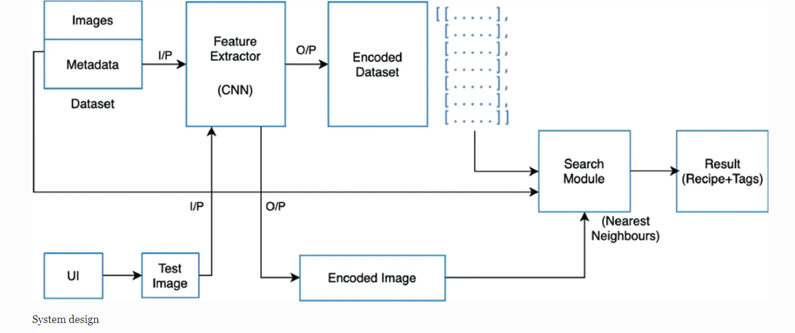
METHODOLOGY
Display Nutritional analysis
Fig. Basic system flow functionality
1

Slide 9
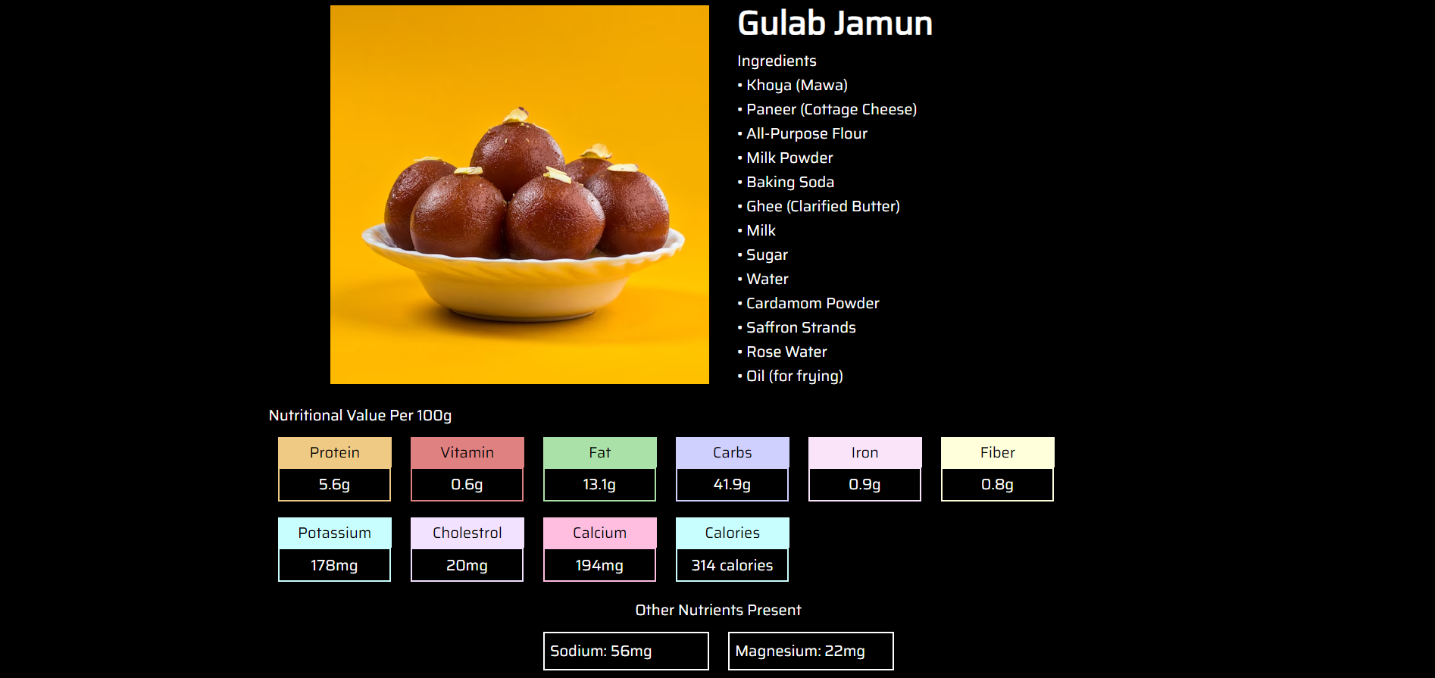
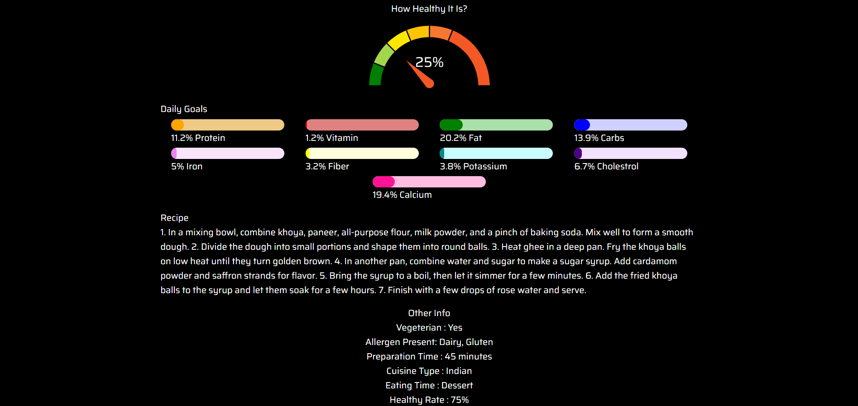
RESULTS
VNFNFRNJRN
Fig. Result page of NutriChef
1

Slide 10
Advantages
User- friendly interface
Promotes Healthy Eating habits
Culinary Exploration and diversity
Ingredient Availability
Variety of Recipes
Positive Impact on Public Health
Raises Awareness of Nutritional gaps
Continual Updates
1

Slide 11
CONCLUSIONS
The utilization of machine learning and computer vision in identifying and analyzing foods has empowered users to make informed dietary choices. The ability to explore the diverse landscape of Indian cuisine, learn about dishes, and understand their nutritional value fosters cultural appreciation and well-informed decision-making. The future scope, including personalized health-driven suggestions, visually similar recipe recommendations, and the introduction of a chatbot, promises to elevate "NutriChef" to new heights of user engagement and nutritional support.
1

Slide 12
REFERENCES
[1] Dorian Raboy, Sabrina Lu,” Image to Recipe/Nutritional Information Generator”, 2020
[2] Moolya, Sakshi Pansare, Anushree Kshirsagar, Sonali Bodekar-Kale, “Recipe Generator Using Deep Learning.” International Journal for Research in Applied Science and Engineering Technology, (IJRASET), vol. 10, no. 5,May 2022, pp. 846–51.
[3] Amaia Salvador, Michal Drozdzal, Xavier Giro-i-Nieto, Adriana Romero,” Inverse Cooking: Recipe Generation from Food Images”, 2019
[4] Javier Marin1 , Aritro Biswas, Ferda Ofli , Nicholas Hynes , Amaia Salvador , Yusuf Aytar , Ingmar Weber , Antonio Torralba,” Recipe1M+: A Dataset for Learning Cross-Modal Embeddings for Cooking Recipes and Food Images”, IEEE TRANSACTIONS ON PATTERN ANALYSIS AND MACHINE INTELLIGENCE, June 2019(Chinese food).
[5] Ekta Belwal, M Sujatha,” Development of foxtail millet incorporated breakfast recipes and their comparison with traditional recipes made of cereals”, Int J Home Sci 2021, vol.7, no.3, pp.147-151.
[6] Srinivasamoorthy.P, Preeti Savant,”RECIPE GENERATION FROM FOOD IMAGES USING DEEP LEARNING”,International Research Journal of Engineering and Technology (IRJET), Volume: 09, Issue 03 ,Mar 2022
1

Slide 13
THANK YOU

